Slide 1
Taxation Acts

Slide 2
Taxation Acts included:
The Sugar Act (1764)- A tax on sugar and molasses imported into the colonies
The Currency Act (1764)- Regulated paper money issued by American colonies
The Stamp Act (1765)- A tax on all paper used for printed materials in the colonies
The Townshend Acts (1767)- A tax on British goods (glass, tea, lead, paints, and paper)
The Tea Act (1773)- Allowed for tea to be shipped by British companies duty-free to the colonies, thus sell at a discounted price

Slide 3
Discussion
Do you believe the taxes presented were unjust enough to cause a violent reaction like the Revolution? Why?

Slide 4
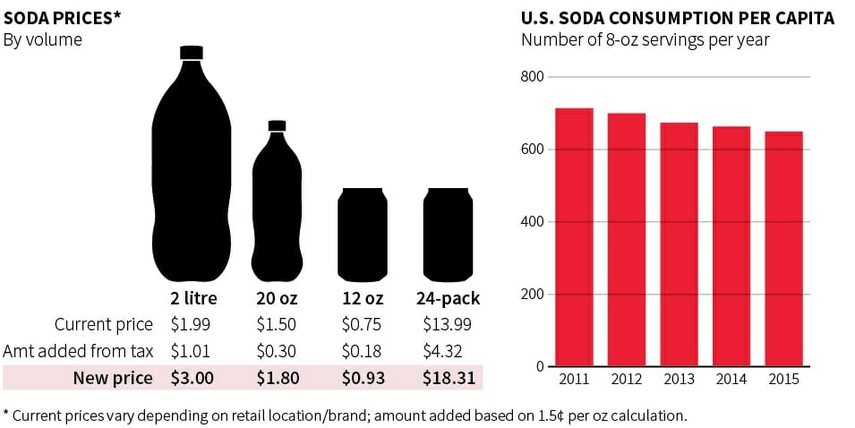
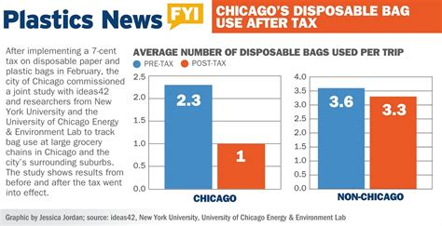
Examples of taxes on products
Today in Philadelphia there is a Soda tax since 2016 where for every soda there is a 1.5 cent tax per ounce of soda. This funds programs like subsidized pre-K and the public works program known as Rebuild.
In Chicago, there is a plastic bag tax since 2017 where citizens of Chicago have to pay a 7 cents per bag tax on both paper and plastic grocery bags.

Slide 5
Discussion Continued
With taxes today being similar to the Taxation Acts, does it change your opinion whether taxes are unjust enough to cause such a violent reaction? Why?

Slide 6
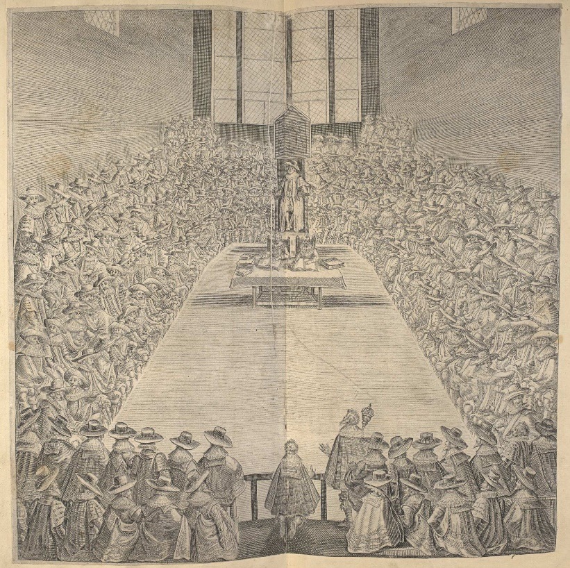
British Constitutional Debate (Ball-Toss Debate)
Did the British government have the right to extend their authority into the colonies?
In this issue of rights to tax a colony, should liberty be involved in this debate? Why?

